Slide 1
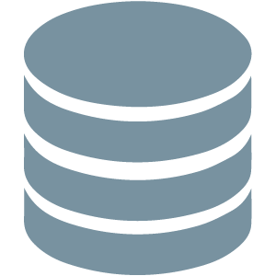
Architectural Web Patterns
Model-View-Controller, Model-View-Template
SoftUni
SoftUni Trainers Team

Slide 2
Databases and ORMs
Design Patterns
Model View Controller Architecture
Model View Template Architecture

Slide 3
Have a Question?
sli.do #DjangoWeb

Slide 4

Design Patterns
Using the Already Invented Wheel

Slide 5
What are Design Patterns?
Design Solutions to well-known programming problems
Can be implemented in any language
Simplify the job of developers
Decrease development time
Ease of communication
https://sourcemaking.com/design_patterns

Slide 6
Creational Patterns
Deal with object creation
Usually competitors to each other - you usually choose one based on your needs and it conflicts with other creational patterns
They aim to separate the proper functioning of a system from how the objects which it requires are created and represented

Slide 7
Behavioral Patterns
Solve common communication problems
Increase code clarity
Increase flexibility
Encapsulate behaviour
Enforce SOLID

Slide 8
C
V
M
MVC
Model-View-Controller

Slide 9
What is MVC?
One of the most used web architectural "design patterns"
Large number of frameworks created for it - ASP.NET Core, Spring Boot, Symfony, Rails, Django
Embraces "Separation of concerns" principle
Stands for Model-View-Controller
Provides URL routing

Slide 10
How it works?
Controller
Interacts with Model and View
Mediator pattern
View
Displays data to the user
Model
Contains the business logic of the application
Responsible for database operations

Slide 11
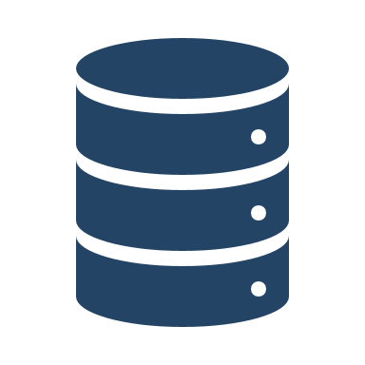

How it works? (2)
Presentation Layer
Controller
Manipulates
Notify
User Action
Send Data
Updates
Model
View

Slide 12
V
T
M
MVT
MVC in Django

Slide 13
What is MVT?
Stands for Model-View-Template
The Django implementation of MVC
MVT analogy to MVC
The model layer serves the same purpose
The view is the controller in MVC
The template is the view in MVC
The "controller" part of a view is a core functionality of Django and that’s why its not called controller (URL routing)

Slide 14
What is MVT? (2)
View
Manipulates
Notify
User Action
Send Data
Updates
Model
Template

Slide 15
Example of a View
from django.http import Http404
from django.shortcuts import render
from app.models import Person
def details (request, pk):
try:
p = Person.objects.get(pk=pk)
except Person.DoesNotExist:
raise Http404("Person does not exist")
return render(request, person/details.html', {'person': p})

Slide 16
Example of a Model
class Person(models.Model):
# field declarations...
def baby_boomer_status(self):
'''Returns the person's baby-boomer status.'''
import datetime
if self.birth_date < datetime.date(1945, 8, 1):
return "Pre-boomer"
elif self.birth_date < datetime.date(1965, 1, 1):
return "Baby boomer"
else:
return "Post-boomer"

Slide 17
Example of Template
{% if latest_question_list %}
<ul>
{% for question in latest_question_list %}
<li>
<a href="/poll/{{ question.id }}/">{{ question.question_text }}</a>
</li>
{% endfor %}
</ul>
{% else %}
<p>No polls are available.</p>
{% endif %}

Slide 18

Django Models

Slide 19
Models
Example Models:
from django.db import models
class Question(models.Model):
question_text = models.CharField(max_length=200, unique=True)
pub_date = models.DateTimeField('date published', auto_now_add=True)
last_updated = models.DateTimeField(auto_now=True)
class Choice(models.Model):
question = models.ForeignKey(Question, on_delete=models.CASCADE)
choice_text = models.CharField(max_length=200)
votes = models.IntegerField(default=0)

Slide 20
Why Do We Even Need Migrations?
We can't just delete the stored data every time we make a small change
The database needs to be synchronized between developers
We may need to fix some bug in a previous version on the project
We need to easily share changes
Migrations are like a version control system for our database schema

Slide 21
Migrations
Keep in mind, that when you are doing basic reverts, you are deleting data permanently
When you revert you still have to rollback your code to the version that was at the time of making the migration
When adding required fields, most likely just doing a migration will not be enough

Slide 22
Migrations
When we make a new Model or change an existing one we have to migrate the database schema:
Showing applied migrations:
Reverting to older migrations:
> python manage.py makemigrations
> python manage.py migrate
> python manage.py showmigrations [optional app name]
> python manage.py showmigrations [optional app name]

Slide 23
Model Managers
Managers is the interface through which database queries are provided to Django Models. Every Model has a Manager
By default it is Model.objects object
You can add Managers or replace the default one
Reasons to do so:
Adding new methods
Restricting the default QuerySet

Slide 24
Managers Methods vs Model Methods
When to use which?
We use Managers when we want "table-level" operations
We use Model methods when we want single "row-level" operation
The business logic stays in the Model that way

Slide 25
Creating Custom Managers
A Manager class has to be a subclass of models.Manager
from django.db import models
class BooksQuerySet(models.QuerySet):
def old_books(self):
return self.filter(pub_date__year__lte=1960)
class SciFiBookManager(models.Manager):
def get_queryset(self):
return BooksQuerySet(self.model, using=self._db)\
.filter(genre__in=['Sci-Fi', 'Science fiction'])
def old_books(self):
return self.get_queryset().old_books()

Slide 26
Managers
Adding a Custom Manager
class Book(models.Model):
# ... field declarations
objects = models.Manager()
scifi_books = SciFiBookManager()

Slide 27
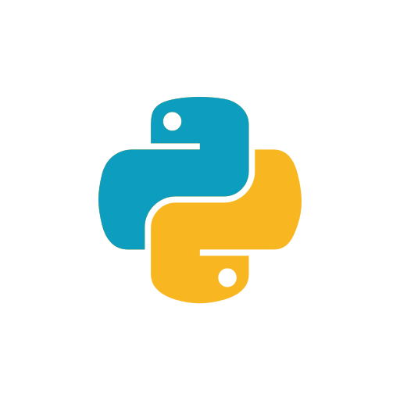
Demo Blog API

Slide 28
Summary
Knowing common design patterns can be extremely helpful
Django follows closely the principles in MVC, adjusting them to create MVT
Migrations are must-know if you want to keep your database data intact

Slide 29

License
This course (slides, examples, demos, videos, homework, etc.) is licensed under the "Creative Commons Attribution-NonCommercial-ShareAlike 4.0 International" license

Slide 31




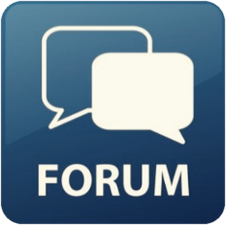
Trainings @ Software University (SoftUni)
Software University – High-Quality Education, Profession and Job for Software Developers
softuni.bg
Software University Foundation
http://softuni.foundation/
Software University @ Facebook
facebook.com/SoftwareUniversity
Software University Forums
forum.softuni.bg

